Slide 1
BE PROJECT PRESENTATION
TOPIC: Neuro-Fuzzy Agent for CV Ranking in HR Systems
TEAM MEMBERS:
Advait Dhananjay Sathe
Shreya Salgia
Raj Surve
Surya Swaminath

Slide 2
INTRODUCTION
In this project, we introduce you to a unique and effective concept of CV Ranking using a Neuro-Fuzzy Agent.
Fuzzy logic is used for modelling the uncertainties and varying consistencies between expert’s preferences using fuzzy sets.
Neural networks are implemented for weighting of the skills and attributes required for that particular job using feature weighting and back-propogation concepts.

Slide 3
ABSTRACT
This system will enable HR departments to determine the most important requirement criteria (experience, skills etc.) for a given job, based on the preferences of different domain experts, while ensuring that the expert’s decisions are unbiased and correctly weighted according to their knowledge and experience.
This will enable a more effective way to short list submitted candidate CVs from a large number of applicants providing a consistent and fair CV ranking policy, which can be legally justified.
This system will focus not only in qualification and experience but also focuses on other important aspects which are required for particular job position.

Slide 4
PROPOSED SYSTEM
This system will automatically determine the key skill characteristic by defining each expert's preferences and ranking decisions.
This system will automate the processes of requirements specification and applicant's ranking.
The proposed system produces ranking decisions that were relatively highly consistent with those of the human experts.
This system will enable a more effective way to short list submitted candidate CVs from a large number of applicants providing a consistent and fair CV ranking policy

Slide 5
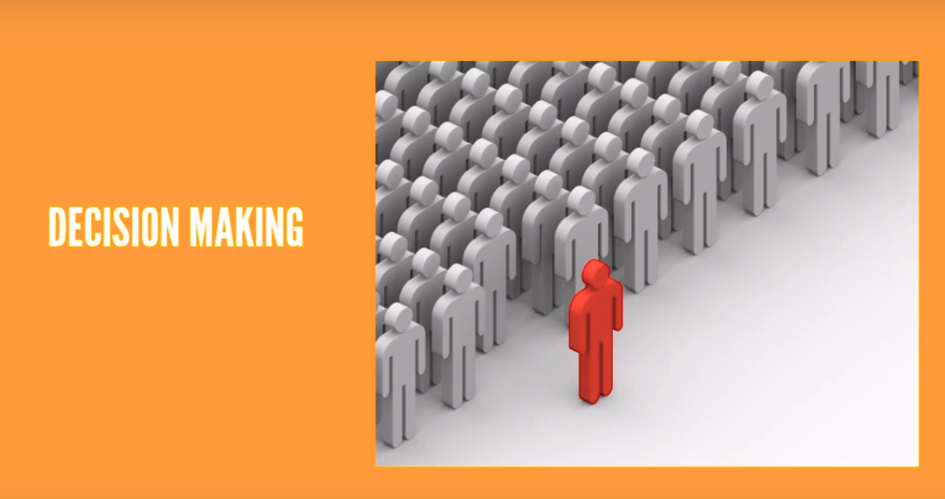

Slide 6
TECHNOLOGY STACK
BACK-END: MySQL Server DB.
Visual Studio.
Machine learning using Python.
FRONT-END: .Net Framework using C#.

Slide 7
DEPENDANCIES
User:This system requires a strong and secured internet connection to be used.
This system can be accessed through laptop,PC,etc.
System:This system requires a large memory for it’s back-end functioning.

Slide 8
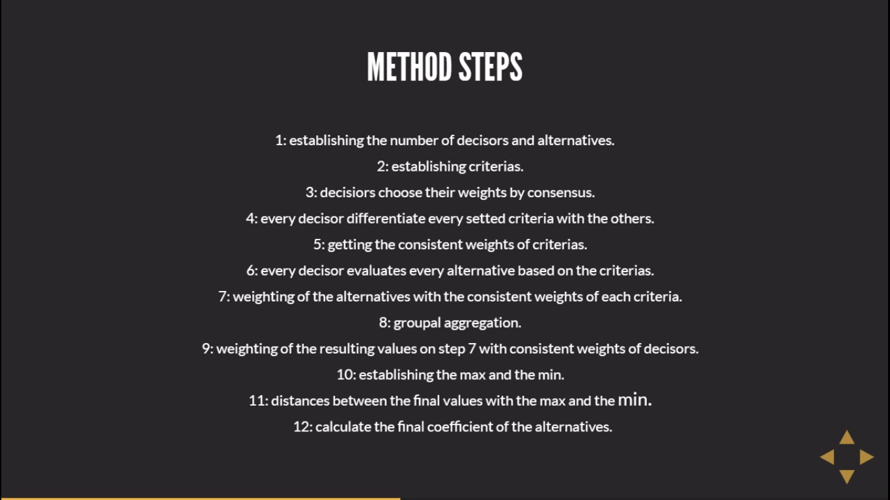
PLANNING AND METHODOLOGY

Slide 9
ADVANTAGES
This system can be used in many business sectors that may require expert candidate.
This system will reduce workload of the human resource department.
This system will help the human resource department to select right candidate for particular job profile which in turn provide expert workforce for the organization.

Slide 10
DISADVANTAGES
This system requires large memory space as it stores data related to CV’s.
Probably this is the only disadvantage for our system.

